Slide 1
Real-time emotion recognition in VR
Sruti Bhattacharjee
Jeremy Di Dio
Ecole Polytechnique Fédérale de Lausanne
Semester Project Fall 2021

Slide 2
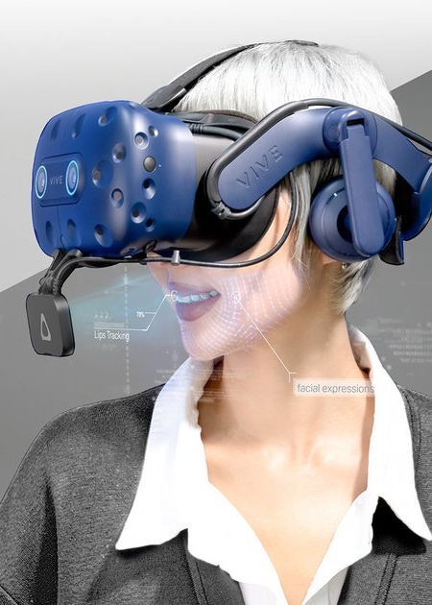
Outline
Project Description
Planning Overview
Current State

Slide 3
Project Description

Slide 4
Planning Overview

Slide 5
Current State

Slide 10


